Slide 1
Introduction to JavaScript
HTML5, CSS3, Javascript and Jquery
by: Seshu Puvvada

Slide 2
Introduction
What is JavaScript
How does it work
Any PC, any OS, any Browser
ECMAScript 5
ECMAScript 6/ ES6/ ES Next
Case Sensitive

Slide 3
Prototype-based programming
Class less programming
Prototype-based programming is an OOP model that doesn't use classes, but rather it first accomplishes the behavior of any class and then reuses it by decorating existing prototype objects.

Slide 4
Script block
Internal scripting
<script> </script>
External scripting
<script src="js/filename.js"></script>

Slide 5
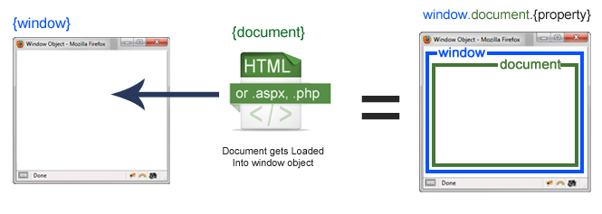
Document Vs Window

Slide 6
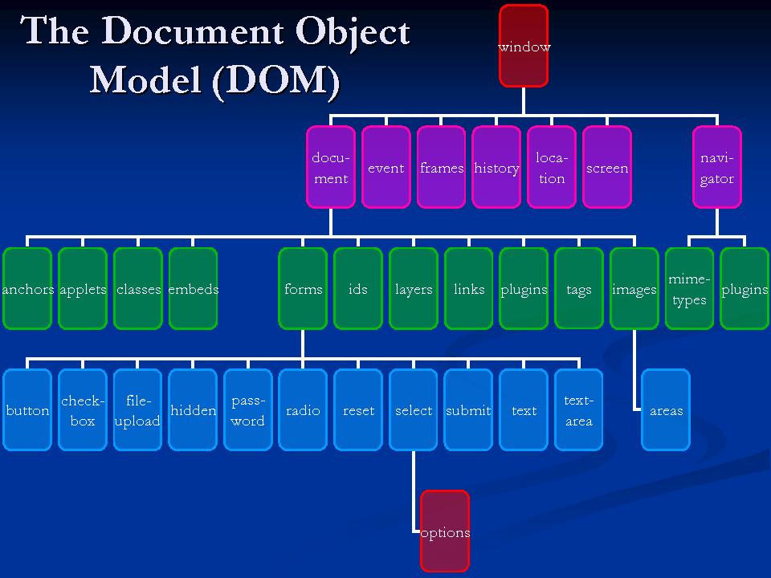
Document Object Model

Slide 7
Simple DOM Manipulation
What is function
What is event
<!DOCTYPE html>
<html>
<head>
<title>Welcome to JS</title>
<script>
function changedata(){
document.getElementById('description').innerHTML = "Text has been changed";
}
</script>
</head>
<body>
<p id="description" > Testing paragraph </p>
<input type="submit" value="Change Data" onclick="changedata()">
</body>
</html>

Slide 8
Dynamic Typing
JavaScript is a loosely typed or a dynamic language. That means you don't have to declare the type of a variable ahead of time. The type will get determined automatically while the program is being processed. That also means that you can have the same variable as different types
var foo = 42; // foo is now a Number
var foo = "bar"; // foo is now a String
var foo = true; // foo is now a Boolean

Slide 9
Data types
Primitive Data type
Boolean (true/false)
Null (null)
Undefined(not assigned any value)
Number
String
Symbol (ES 6)
Object
Notes:
Primitive Data type – is data that is not an object and has no methods. s

Slide 10
Variables
var keyword
Scope
Global and local variable
Variable declaration
var x = 1;
var str = ‘hai’;
var isStr = true;
Printing variable – console.log(var names)
typeof -- to find variable type

Slide 11
Logical Operators
== equal to
=== equal value and equal type
!= not equal
!== not equal value or not equal type
> greater than
< less than
>= greater than or equal to
<= less than or equal to

Slide 12
Program Flow
Conditional statements
if
if, else
if, else, else if
while
do while
for
break
switch
Functions
Function
Function with input parameters
Function with and without return

Slide 13
Object
An Object is collection of properties. These properties can either be primitive datatypes or other objects or functions.
Predefined objects array, date etc…
Custom objects
Var obj = { };

Slide 14
Array
Array – to store multiple values in single variable
Var myarr = [‘one’, ‘two’, ‘three’];
Accessing array items – myarr[1]
Changing elements myarr[1]
STACK principle – LIFO
Properties
Length
Push
Pop
toString()
Join(“ “)
Shift – removed element at first place (index 0)
Unshift – adds element at firstplace
Splice(2, 0 , obj1, obj2) – add items at position 2, 0 don’t delete any items
Sort – default sort
Concat – arr1.concat(arr2) – will add arr2 to arr1
Slice(1, 3) – slice elements from index 1 to 3.

Slide 15
String properties
Str.length
Escape char – “I am \”frontend developer\””
\n – for new line
indexOf
lastIndexOf
Replace
Search
Split – convert string to array
Substr
Substring
toLowerCase
toUpperCase

Slide 16
Error handling
Try
Catch
Finally
Throw
try{ //something here throw “custom error” ; }catch(err){ }finally{ //something here }

Slide 17
DOM Manipulation methods
Javascript can change HTML elements, Attributes, CSS Styles
Removing existing HTML elements, Attributes, CSS Styles
Create and reach events on page.
document.getElementById(“id").innerHTML
document.getElementsByTagName(“tagname”)
document.getElementsByClassName(“classname”)
document.querySelectorAll
document.querySelector

Slide 18
HTML Elements manipulation
innerHTML
attribute / setAttribute
style.property
createElement
removeChild
appendChild
replaceChild

Slide 19
Events
onclick
onload
Onchange
Onkeypress/onkeydown
onmouseover
onmouseout
addEventListener
removeEventListener

Slide 20
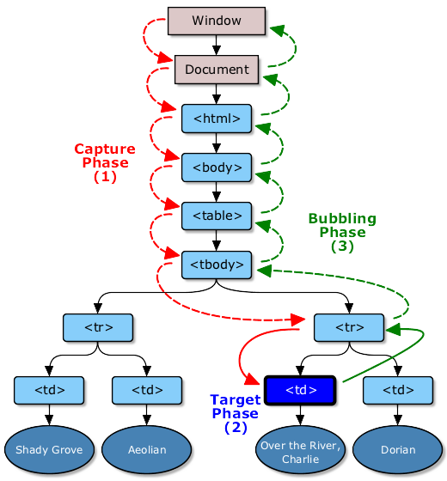
Event Propagation
Event
Type
Target
Current target
Cancelable
Bubbles
preventDefault
Stoppropagation
stopImmediatePropagation
Event Phases
Capture
Target
Bubbling

Slide 21
Date Object
new Date()
new Date(milliseconds)
new Date(date string)
new Date(year, month, day, hours, minutes, seconds, milliseconds)
Formats
YYY-MM-DDTHH:MM:SS
YYYY-MM
YYYY
MMM DD YYYY
MM/DD/YYYY
MM:DD:YYYY
Methods
getDate(), getDay(), getFullYear()
getHours(), getMinutes(), getMonth(), getTime()

Slide 22
Javascript Object/ Class/ Namespace
Object
Class
Namespace
With properties
With properties and functions

